Slide 1
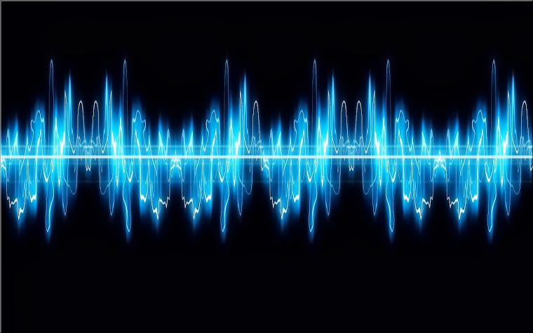
Pattern Recognition
Presented by :
Mohamed Abdelfattah Younes
Mohamed Khaled Abdelmonem
Abdelrahman Mostfa Anwar
Mohamed Ibrahim Mohamed
Mohamed Yousef Mohamed
Mahmoud Ayman Ahmed
Supervised by: Dr/: Hafez Abd El Whab

Slide 2
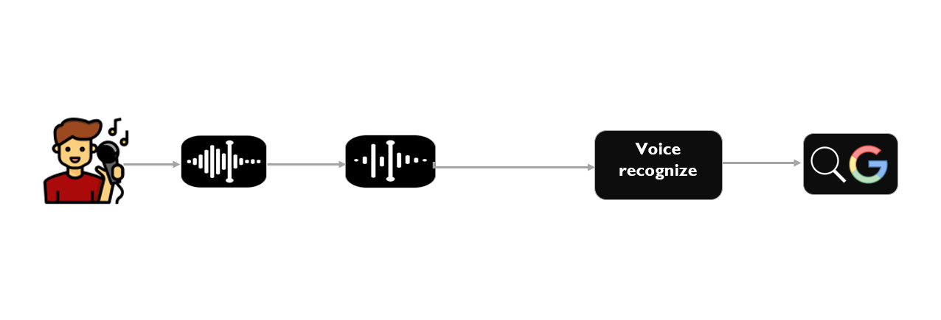
Block Diagram

Slide 3
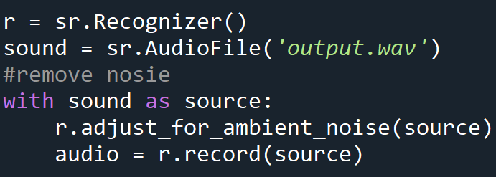

Noise Adjust
Adjusts the energy threshold dynamically using audio from source (an AudioSource instance) to account for ambient noise
Should be used on periods of audio without speech - will stop early if any speech is detected.
The duration parameter is the maximum number of seconds that it will dynamically adjust the threshold for before returning. This value should be at least 0.5 in order to get a representative sample of the ambient noise.

Slide 4

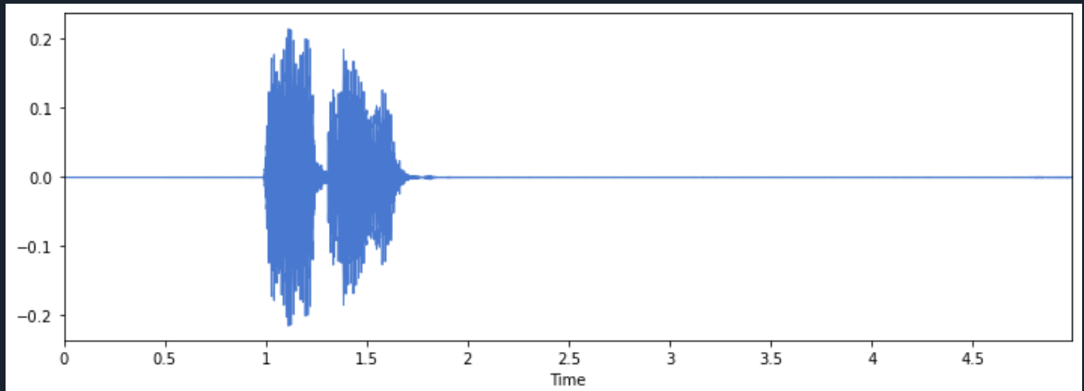
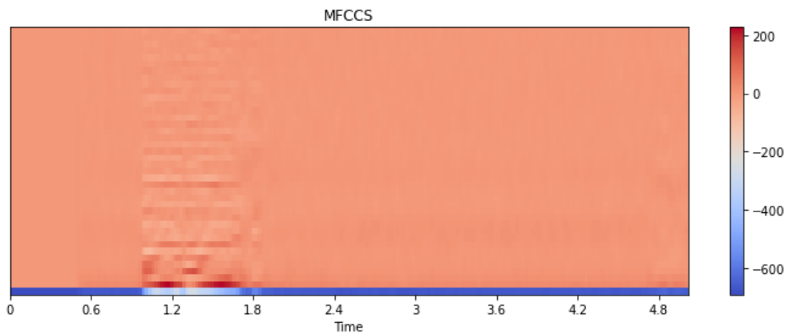
ORIGNAL SIGNAL

Slide 5
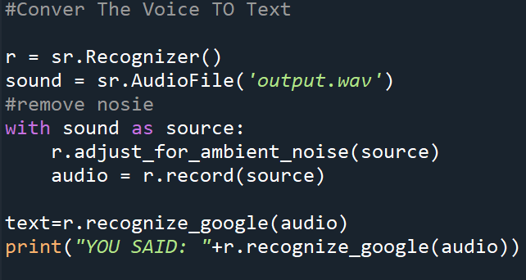
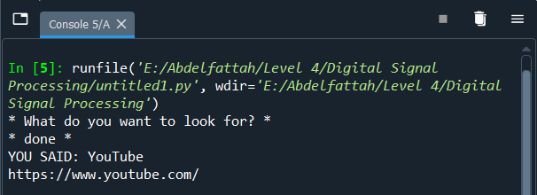
Voice recognizer
Output

Slide 6
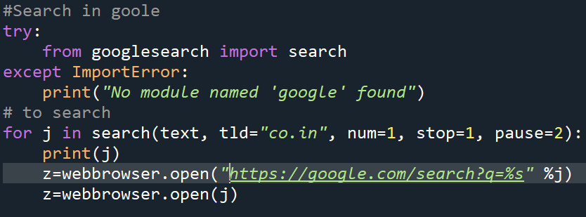
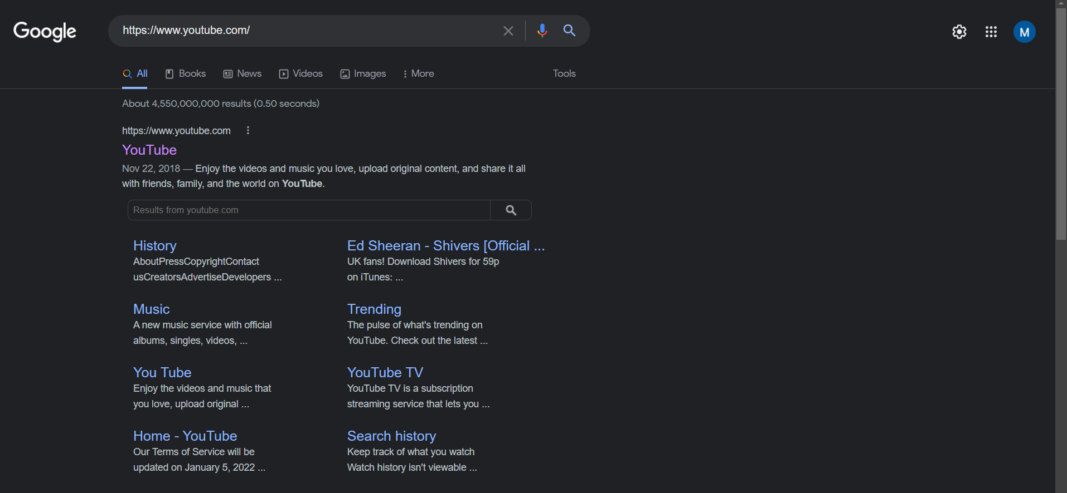
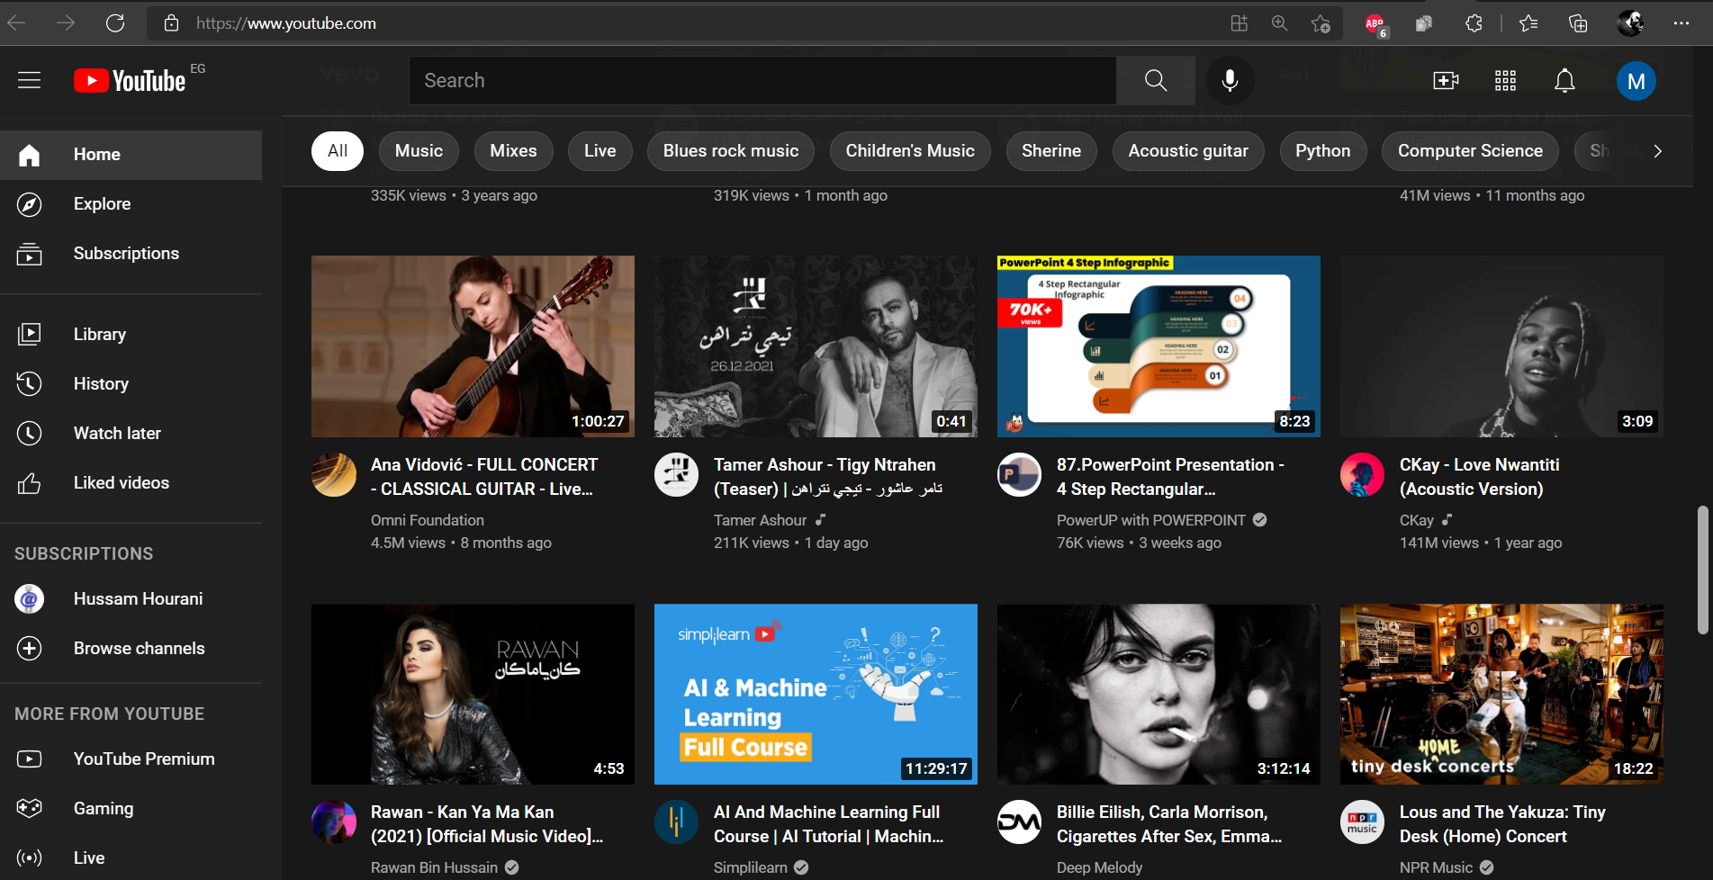
Search in Browser

